Slide 1
Bony pelvis
By: m. g. Hammad

Slide 2
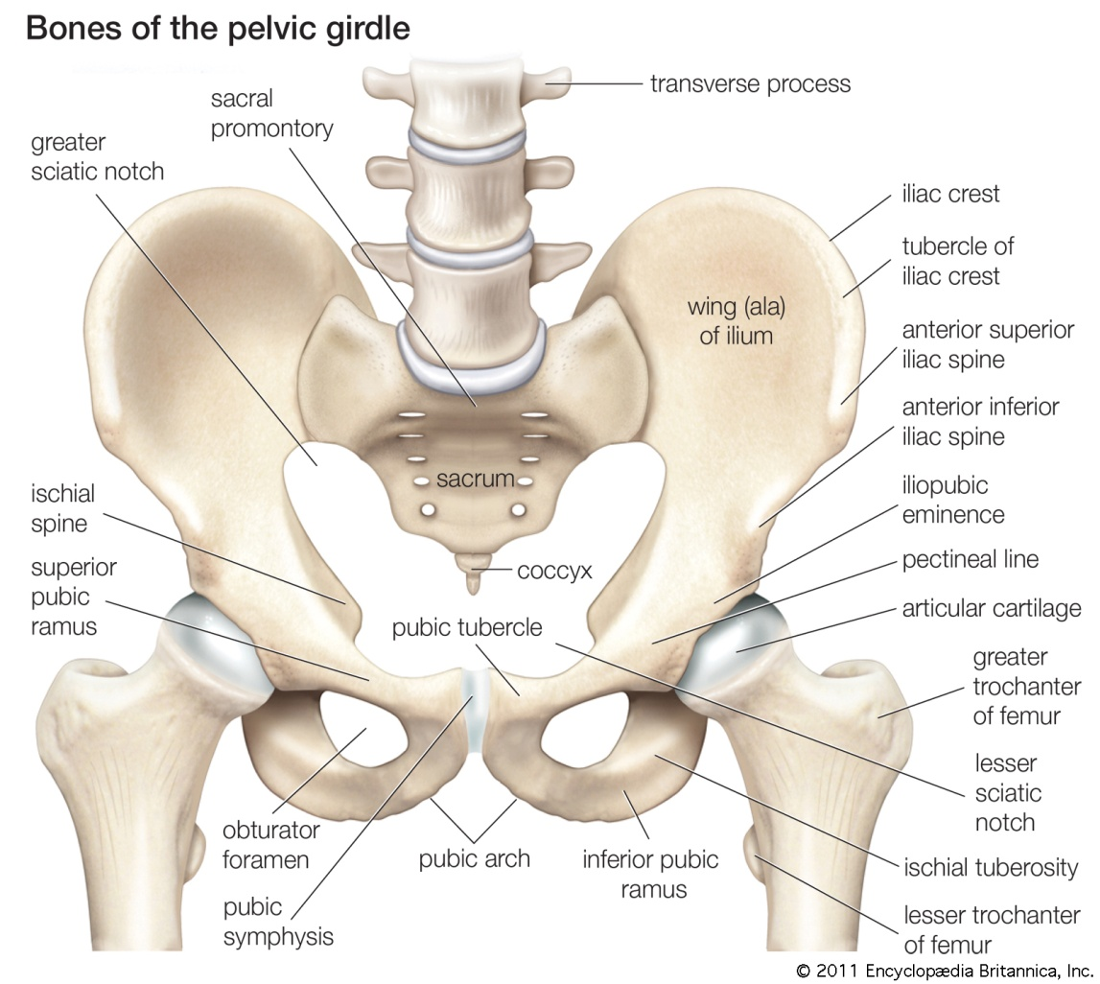
The pelvis
Region of the trunk that lies below the abdomen.
For description:
Pelvic wall.
Pelvic cavity.

Slide 3
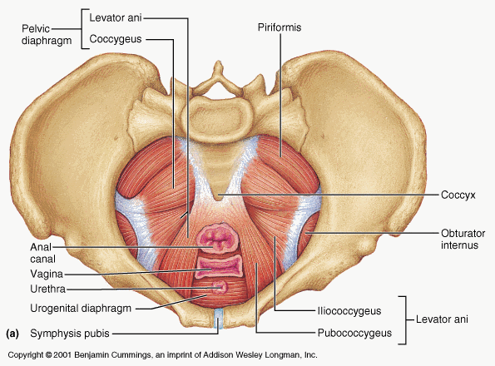
Pelvic wall
Consists of 2 parts:
Bony part (bony pelvis).
Soft tissues:
Muscles (pelvic diaphragm).
Ligaments & Fascia.

Slide 4
Functions of bony pelvis
Transmit the weight of the body from the vertebral column to the femurs.
Contains, supports, and protects the pelvic viscera.
Provides attachment for trunk and lower limb muscles.

Slide 5
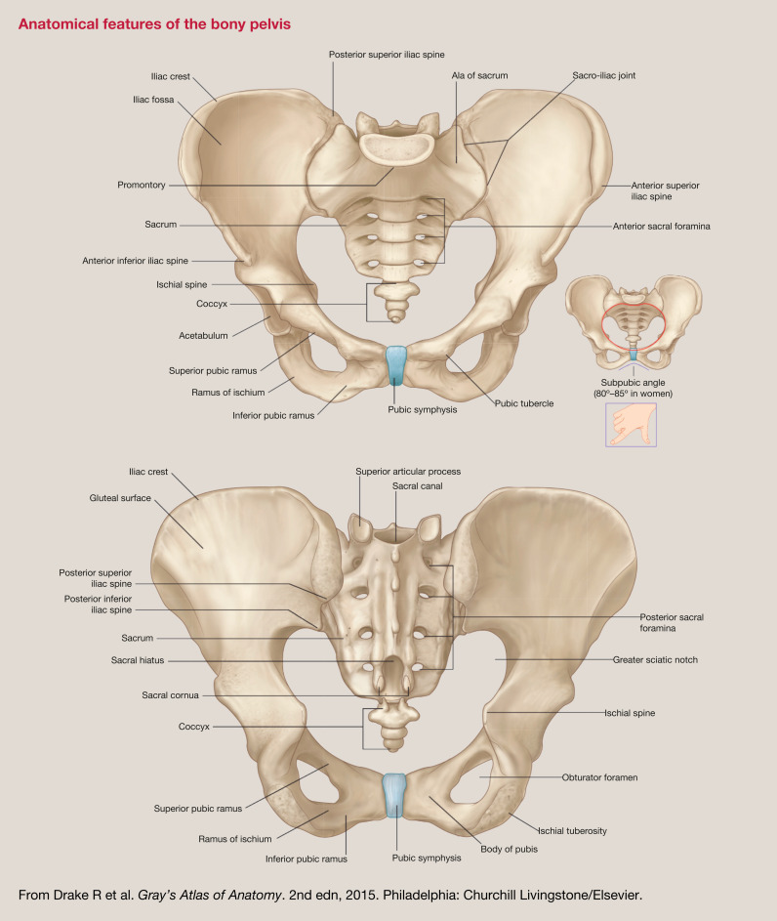
components of bony pelvis
The bony pelvis is composed of four bones:
R & L hip bones: lateral & anterior walls of BP.
Sacrum & Coccyx: posterior wall of BP.

Slide 6
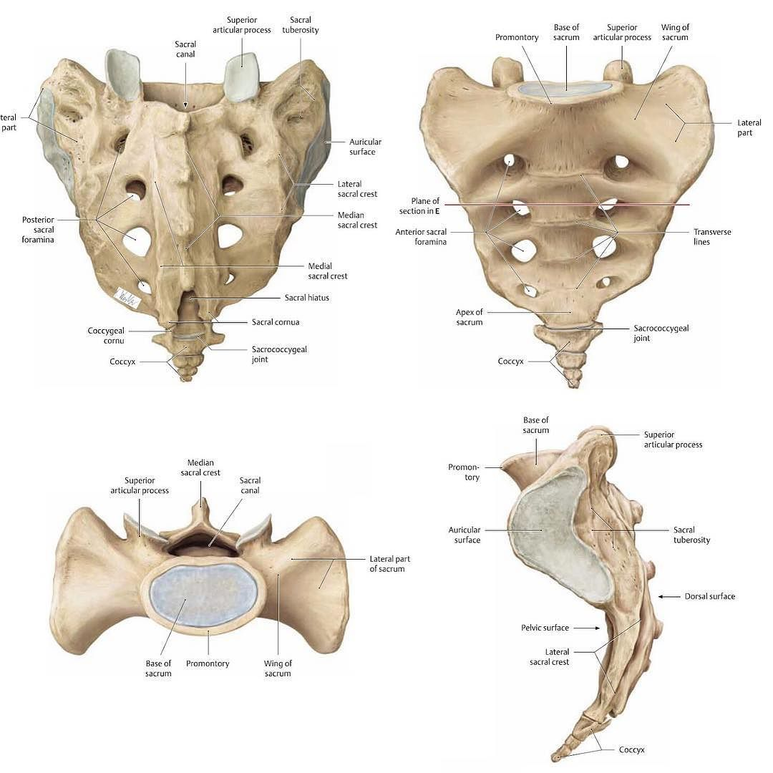
The sacrum
Part of vertebral column.
Made up of 5 pieces, which fuse together forming a triangular bone.
It concave anteriorly.

Slide 7
Anterior view of sacrum
Concave.
Upper margin of S1: Promontory.
Central mass: fusion of sacral vertebral bodies.
Transverse lines: in central mass; remark intervertebral joints.
Anterior sacral foramina: 4; transmit anterior rami of upper 4 sacral nerves.
Lateral mass: lateral to anterior sacral foramina, formed by fusion of TP of SV.
Ala {wing}: expanded TP of S1.

Slide 8
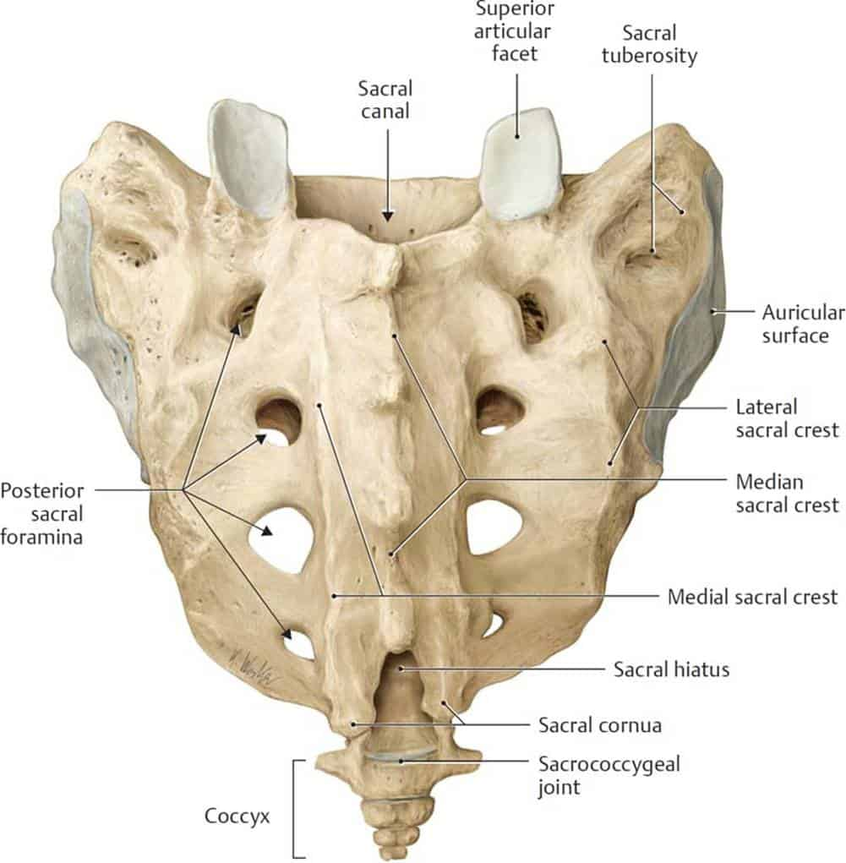
posterior view of sacrum
Sacral canal.
Superior articular facets of S1: besides sacral canal
Median sacral crest: fusion of spines of SV.
Medial sacral crest: fusion of articular processes of SV.
Posterior sacral foramina: 4; transmit posterior rami of upper 4 sacral nerves.
Sacral hiatus: unfused laminae of S4 or S5; it ends by 2 sacral horns, it transmits 5th sacral nerve.
Sacral tuberosity: on back of ala.

Slide 9
sacrum

Slide 10
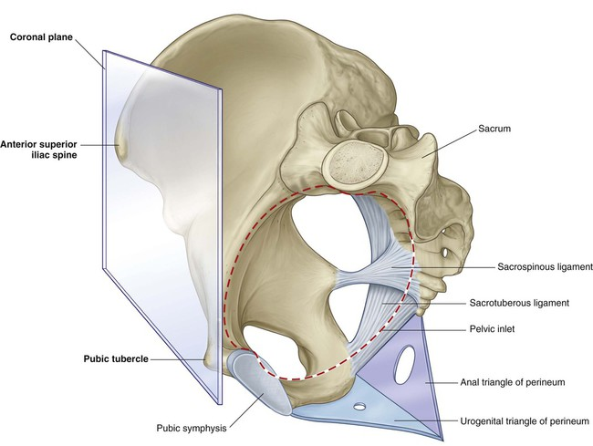
Orientation of the Pelvis
In standing anatomical position:
The front of the symphysis pubis and ASIS lie in the same vertical plane.
Pelvic surface of the symphysis pubis faces upward and backward.
Anterior surface of the sacrum is directed forward and downward.

Slide 11
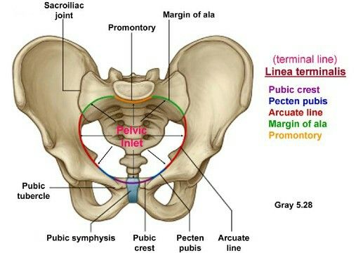
divisions of the Pelvis
It divided into 2 parts by PELVIC BRIM.
Pelvic Brim {linea terminalis}:
Formed by:
Upper margin of SP (anteriorly).
Pectineal line & Arcuate line (laterally).
Ala & Promontory (posteriorly).

Slide 12
divisions of the Pelvis
Divisions are:
False Pelvis:
Above pelvic brim.
It is part of abdominal cavity.
True Pelvis:
Below pelvic brim.
Also called pelvic cavity, lesser pelvis.
Has 2 ends:
Upper: Pelvic Inlet.
Lower: Pelvic Outlet.

Slide 13
divisions of the Pelvis
Pelvic inlet:
It is the pelvic brim.

Slide 14
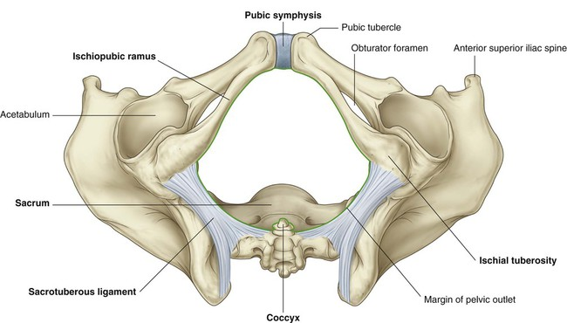
divisions of the Pelvis
Pelvic outlet:
Boundaries:
Anteriorly: Pubic Arch.
Laterally: Ischial Tuberosity.
Posterolateral: Inferior margin of the Sacro tuberous ligament.
Posteriorly: Tip of the coccyx.

Slide 15
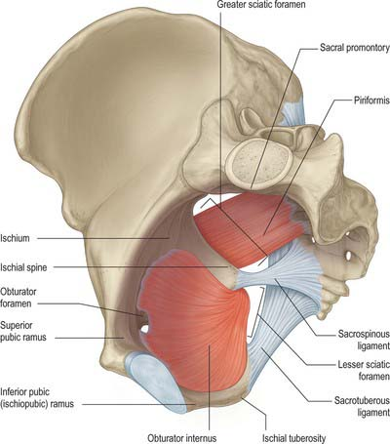
divisions of the Pelvis
True Pelvis
Between the pelvic inlet and the pelvic outlet.
Bounded by the pelvic surfaces of the hip bones, sacrum, and coccyx.
Includes the true pelvic cavity and the deep parts of the perineum.

Slide 16
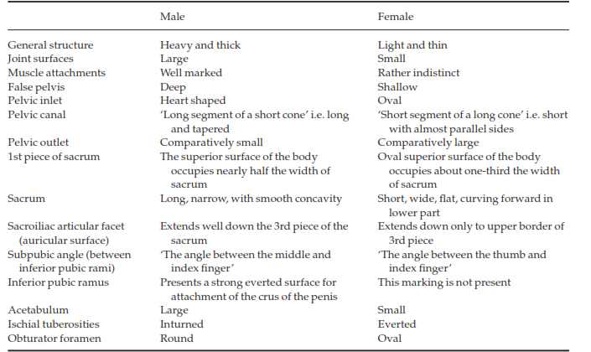
Comparison of male and female pelvis

Slide 17
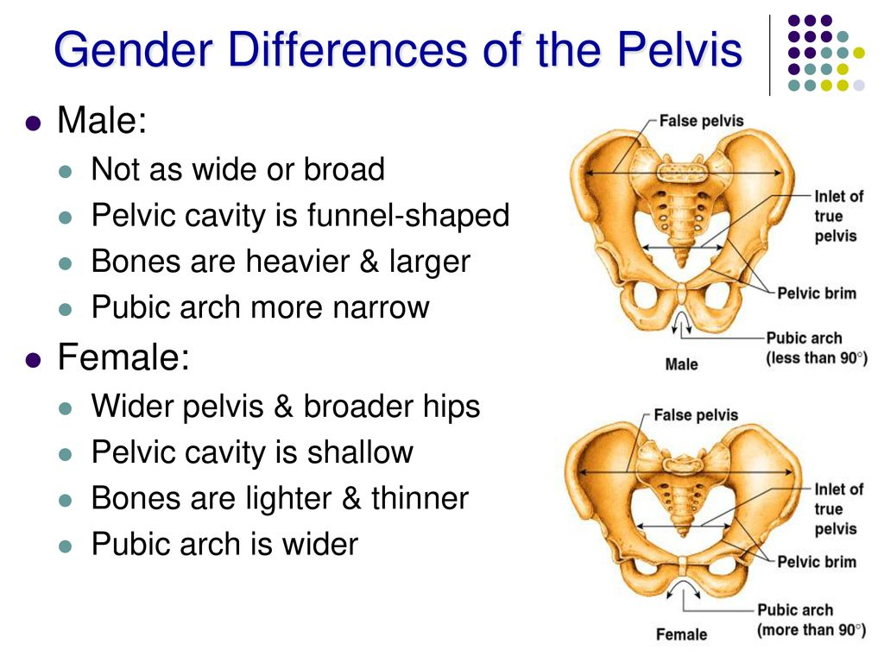
Comparison of male and female pelvis

Slide 18
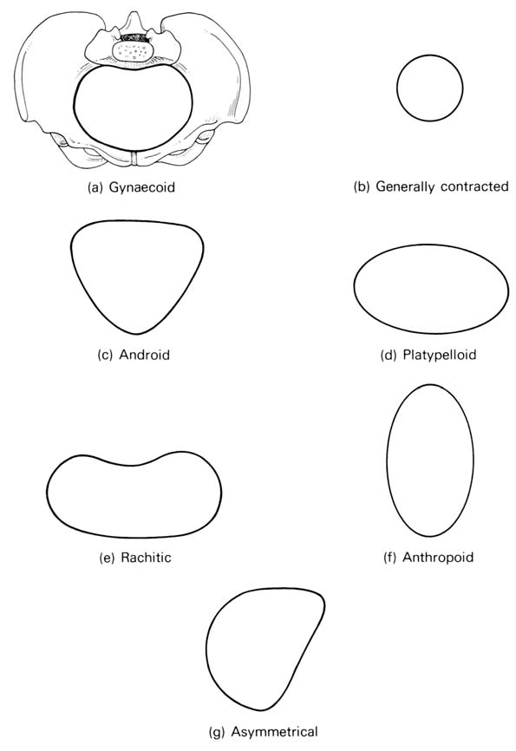
Variations of the female pelvic shape
The female pelvic shapes may be subdivided (by Caldwell and Molloy) as follows:
Normal shape: with many variants.
The Rachitic ﬂat pelvis: The sacrum is rotated so that the sacral promontory projects forward and the coccyx tips backwards.
The A symmetrical.

Slide 19
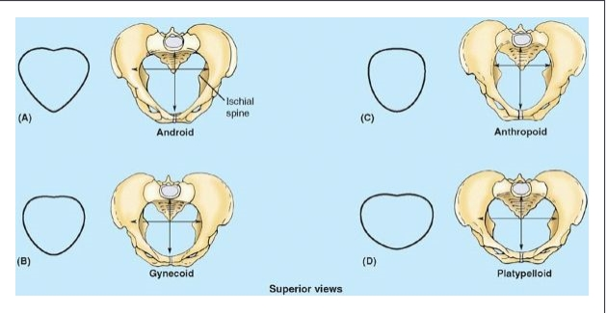
Variations of the pelvic shape
Variation in normal shape of pelvis:
Gynecoid: normal.
Android: the masculine type of pelvis.
Platypelloid: shortened in the anteroposterior diameter, increased in the transverse diameter (the ‘non-rachitic ﬂat pelvis’).
Anthropoid: much lengthened anteroposterior and a shortened transverse diameter.

Slide 20
Thank you
Merci
Grazi

